Slide 1
Visvesvaraya Technological university “jnana sangama”Belagavi-590018
TITLE
ANTHROPOMORPIC ROBOTIC HAND
( CONTROL OVER TELEMANIPULATION AND
MYOSENSORS )
GOPALAN COLLEGE OF ENGINEERING AND MANAGEMENT
BACHELOR OF ENGINEERING
ELECTRONICS AND COMMUNICATION
Submitted by: Internal guide:
Assistant professor
Jyothi yadav (1GD14EC018) Mr. Mahesh Hiremath
Srinivas shinde (1GD14EC039)

Slide 2
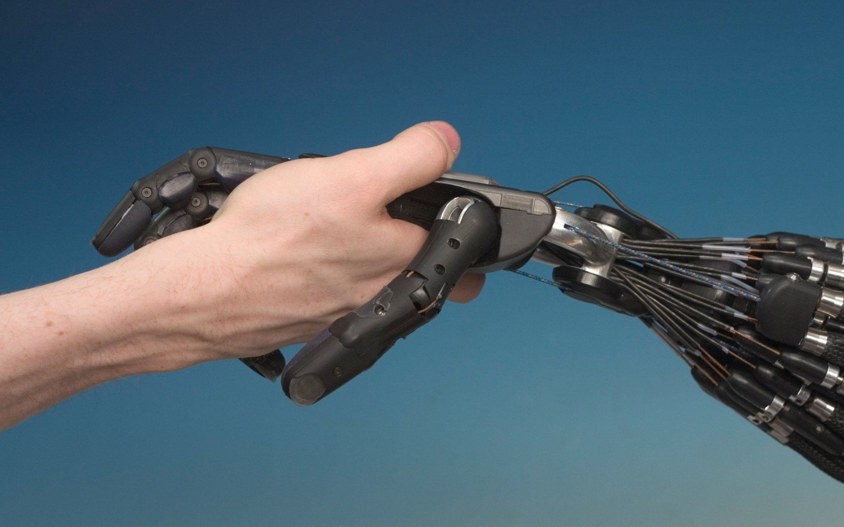
ANTHROPOMORPIC ROBOTIC HAND
( CONTROL OVER TELEMANIPULATION AND
MYOSENSORS )

Slide 3
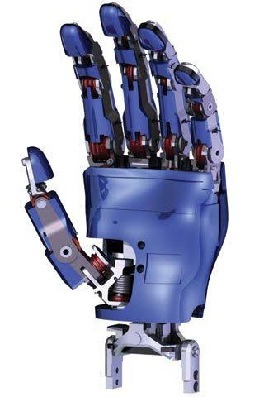
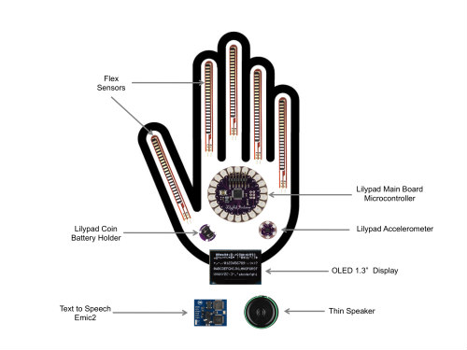
Overview of the project
Mechanical design and fabrication of humanoid robotic hand with multiple control
Finger angel
signals
Actuation signal
Microcontroller
-ATmega328
Force feedback
( tactile sensor signal)
Touch signal
Telemanipulation using sensor glove

Slide 4
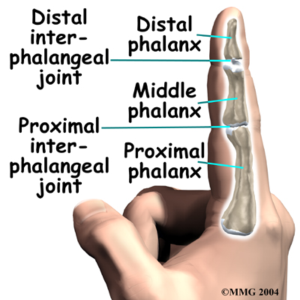
Mechanizing the bio movement
The human hand has 5 complex fingers With 3 independent joints for each finger
15 joints require 30 linear actuators with additional 10 for side flex
Human palm is approx 9x9 cm
LA1
LA2

Slide 5
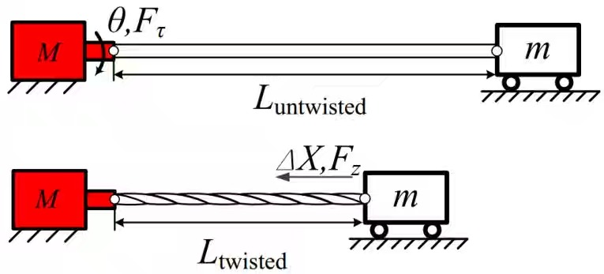
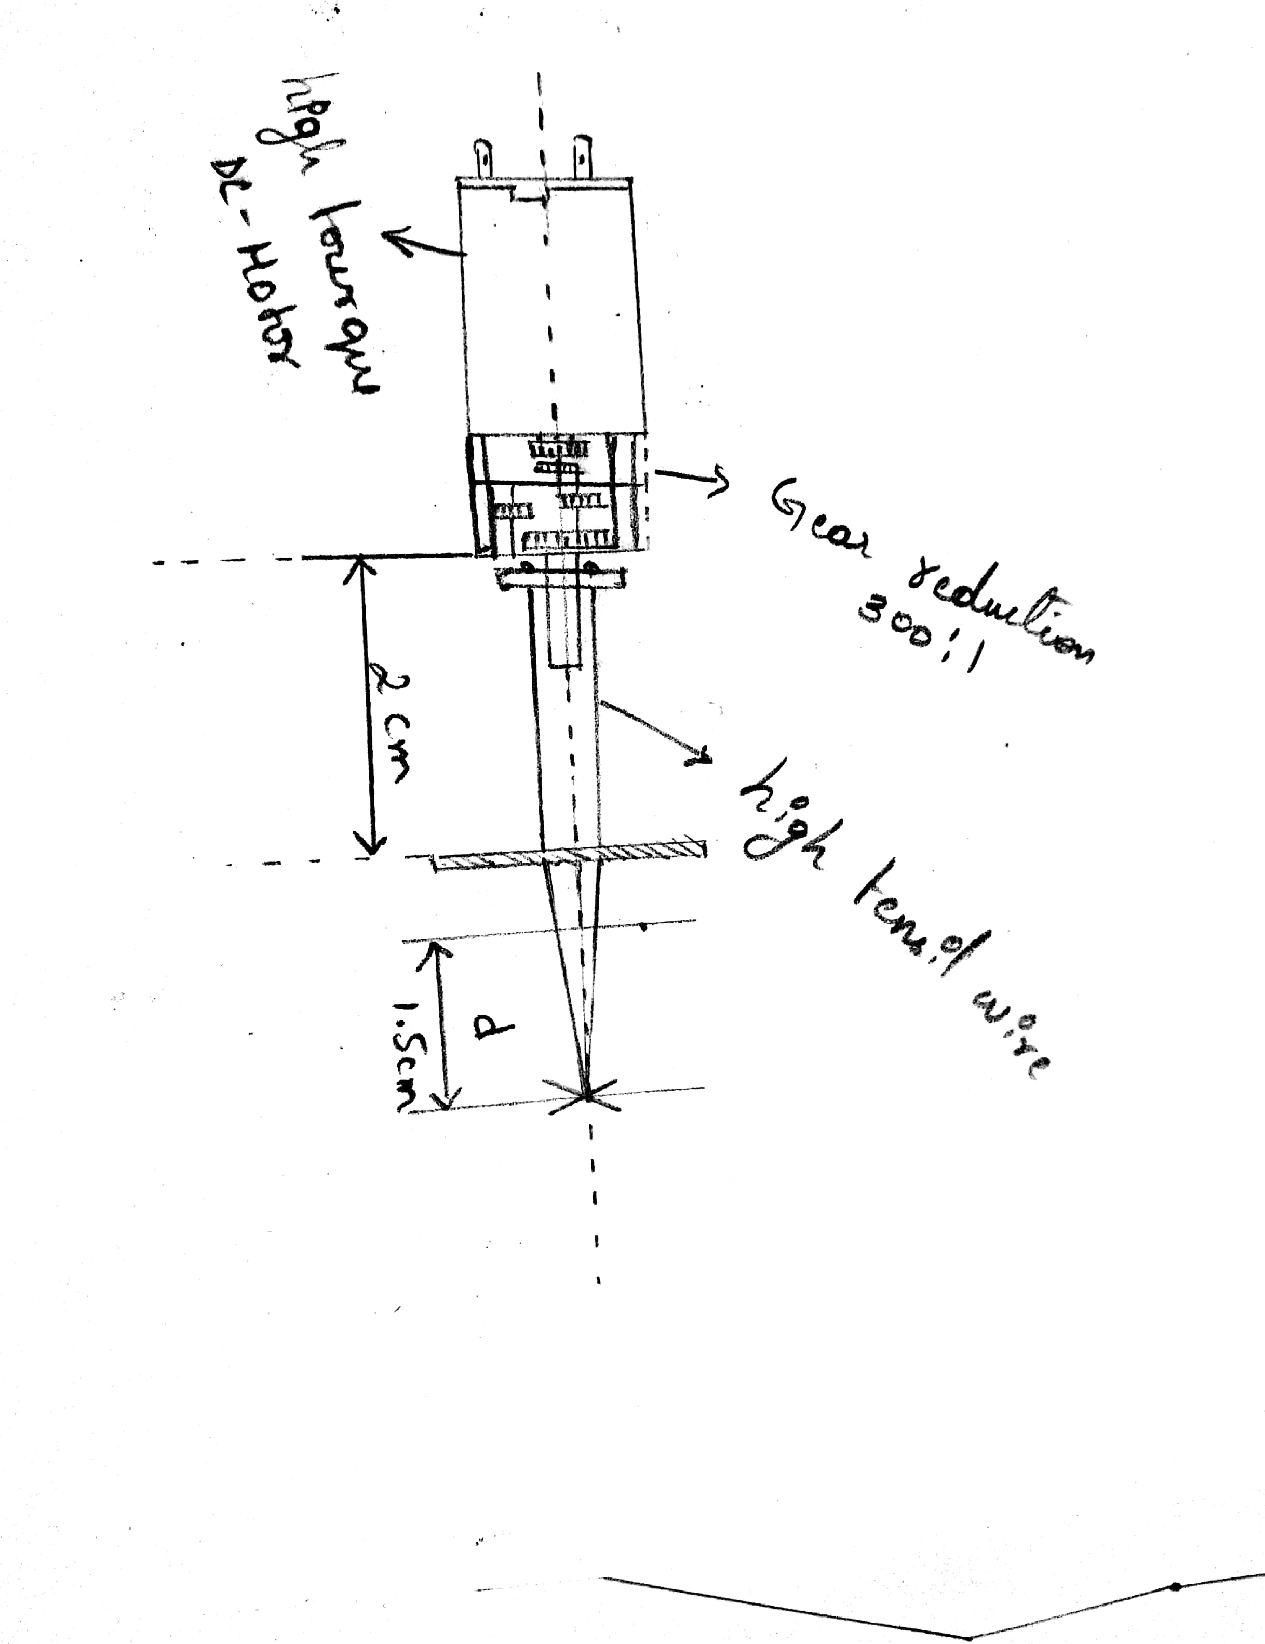
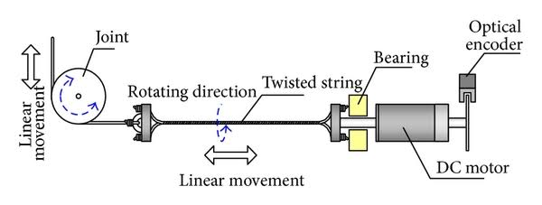
High torque linear muscle mechanics using TSA principal
(Twisted string actuation)
TSA is a mechanical process in which a group of parallel fiber strands
Of same length are helically wound in order to decrease the over all axial length

Slide 6
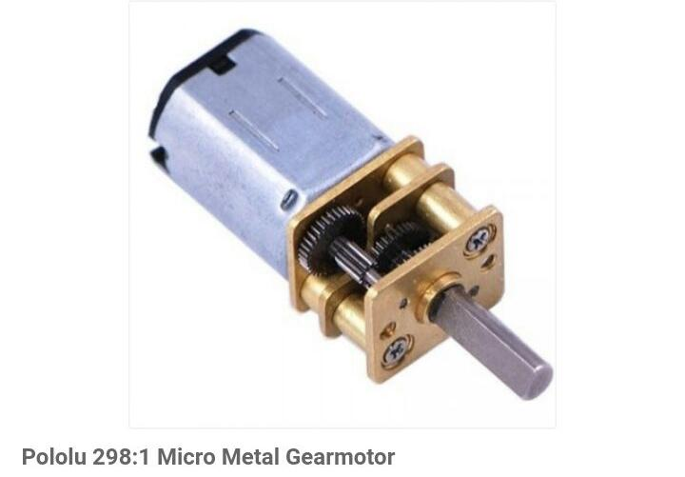
Industrial grade high torque geared motor
The gear motor has a cross section of 10 x 12mm
12v high power carbon brushes
gear ratio 298:1
speed 100rpm
Torque 70 N.m
Low torque
High rpm
High torque
Low rpm

Slide 7
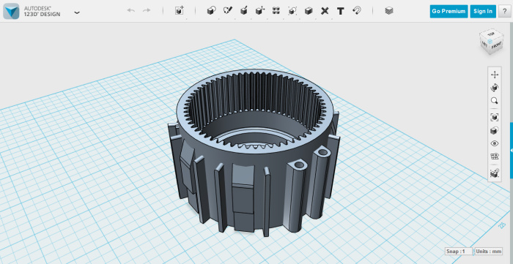
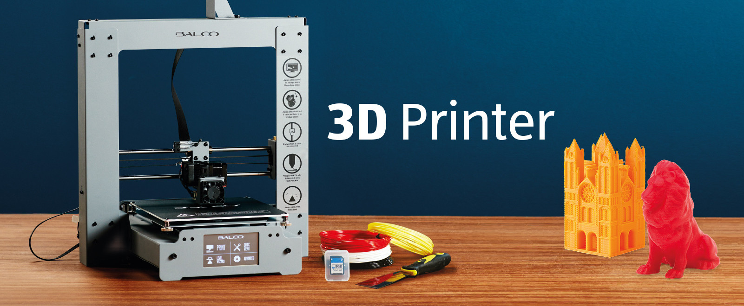
3D designing and 3D printing
Complex small parts are designed using 123D Autodesk open source free software
Conversion of the 3D model into 3D printable files and printing them using 3D printers for more robust and fine quality

Slide 8
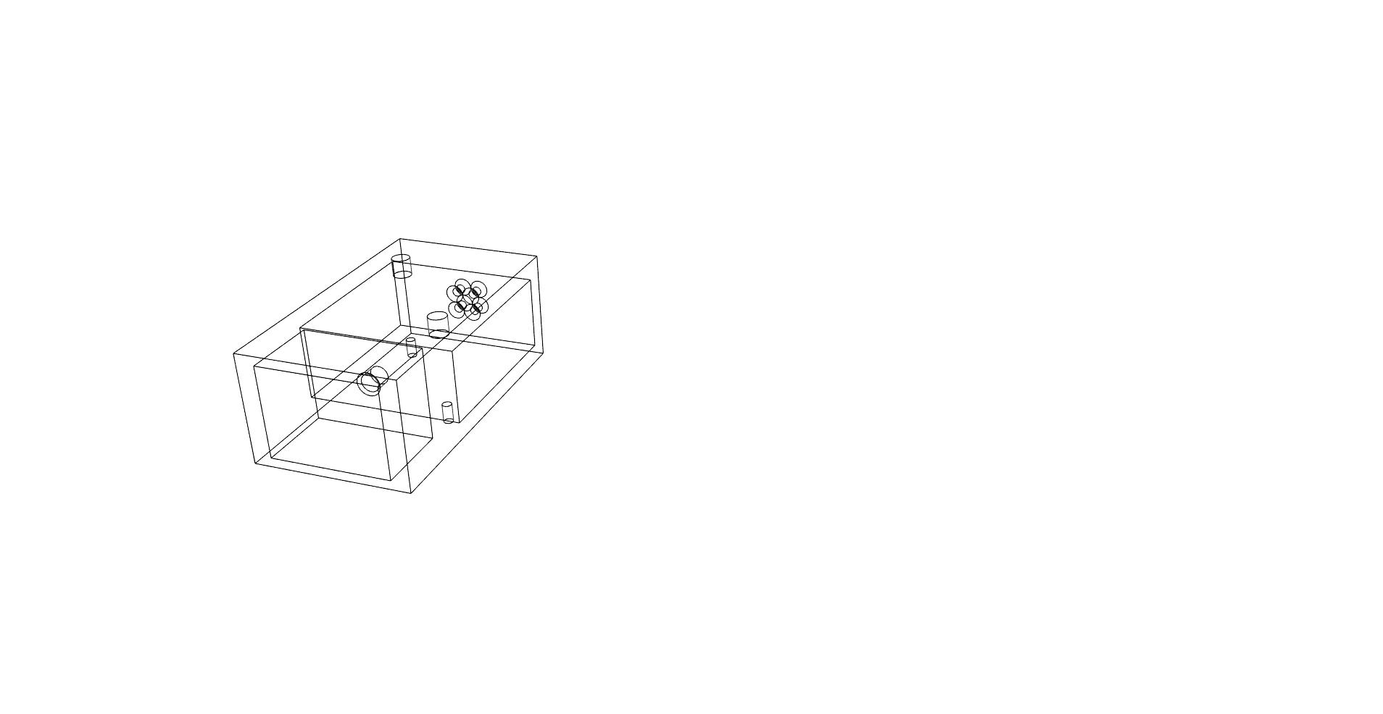
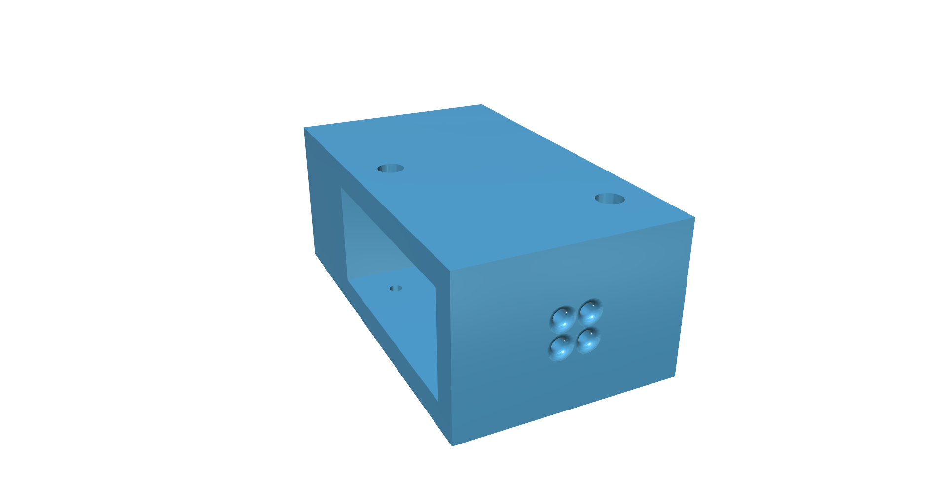
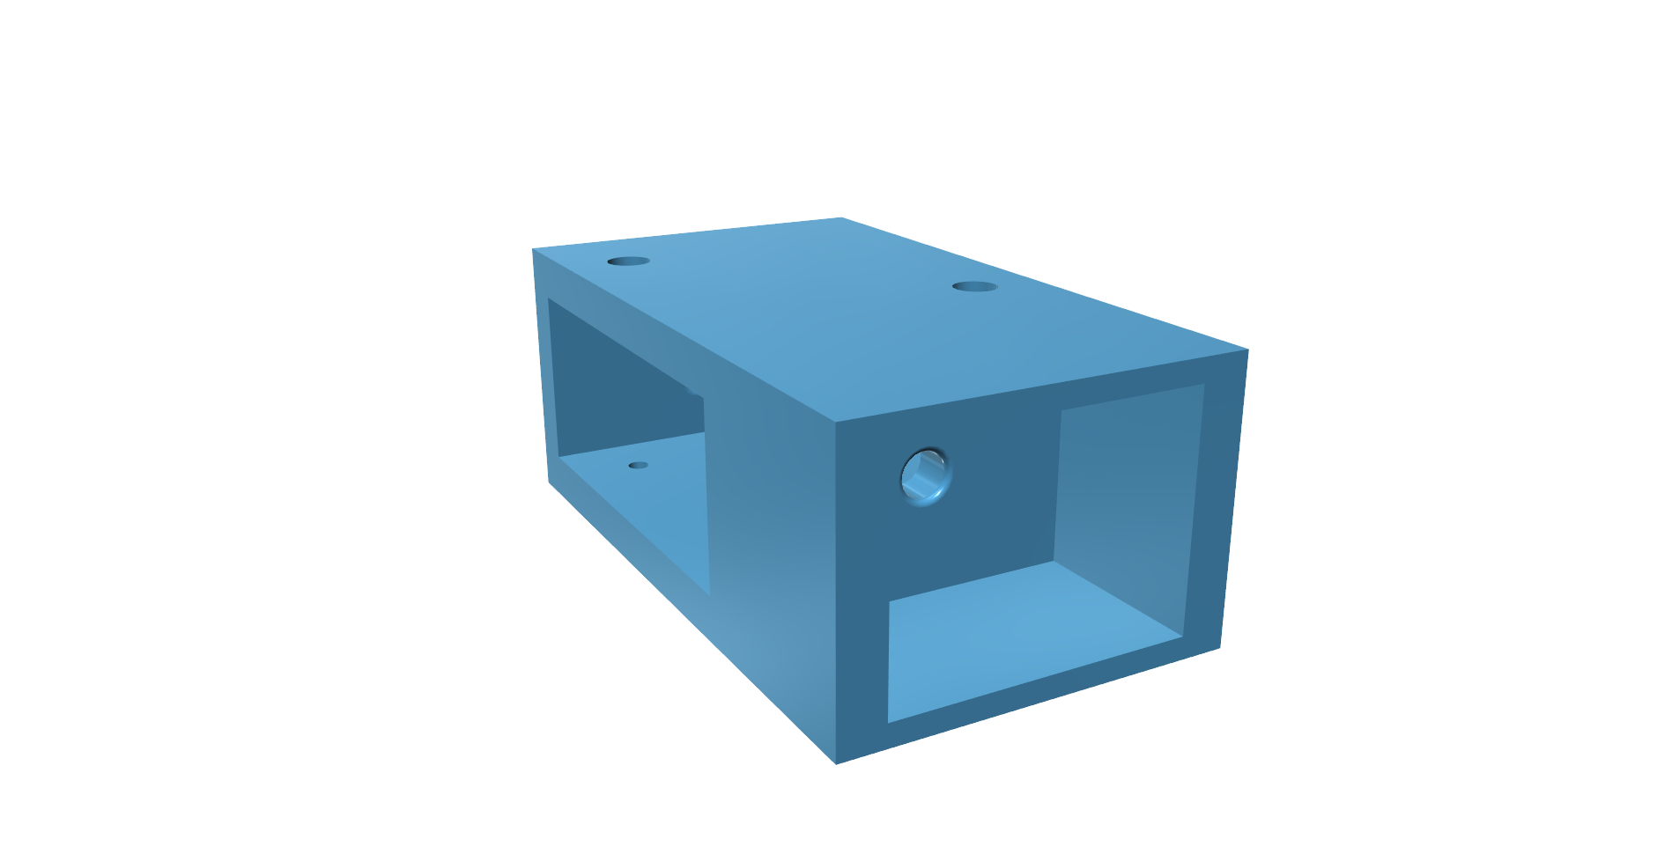
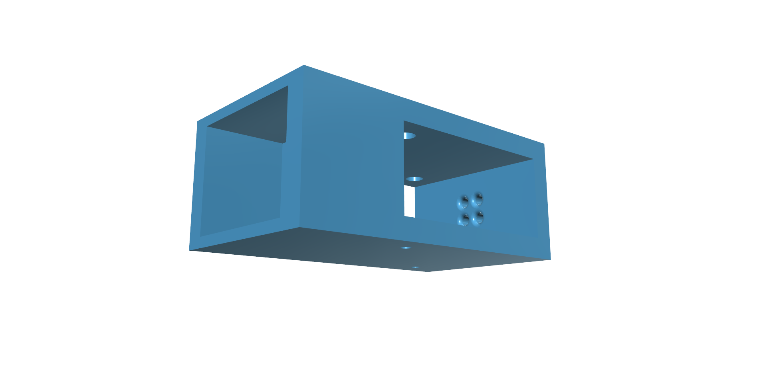
3D designed parts using Autodesk

Slide 9
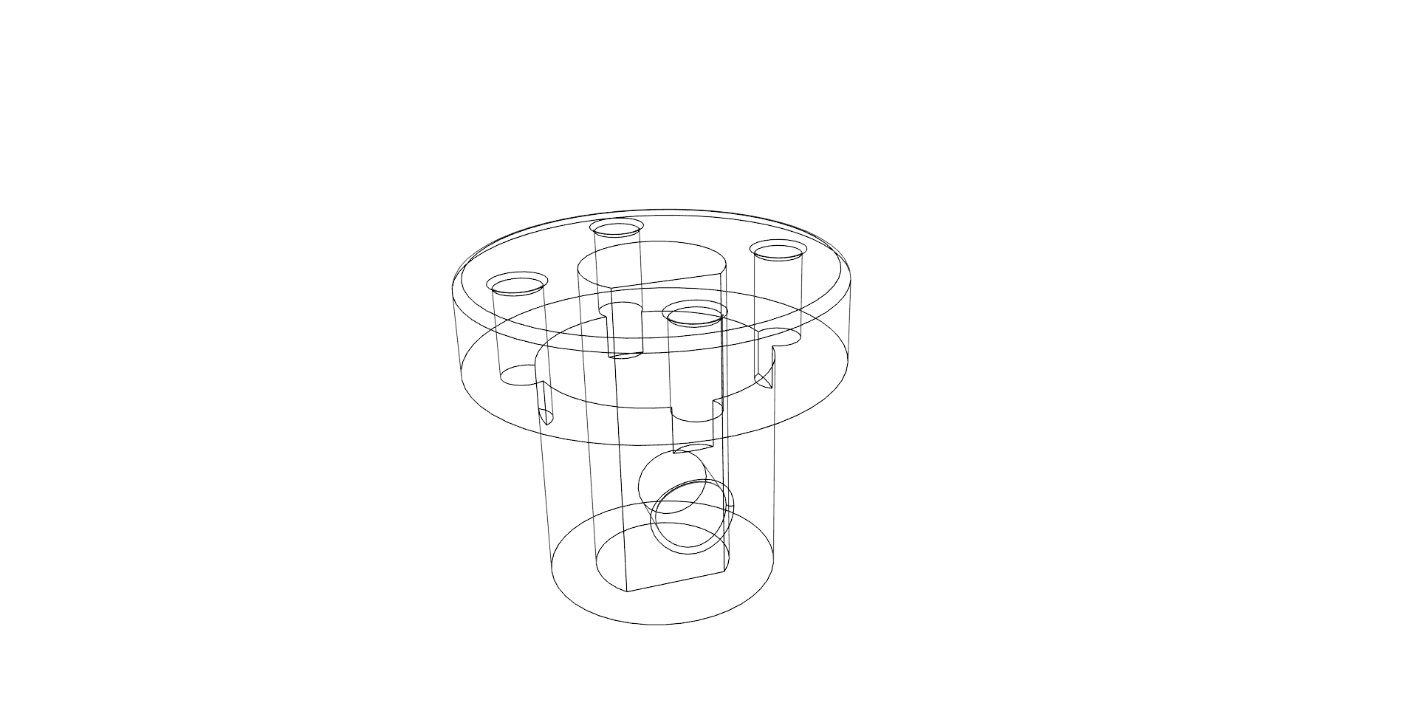
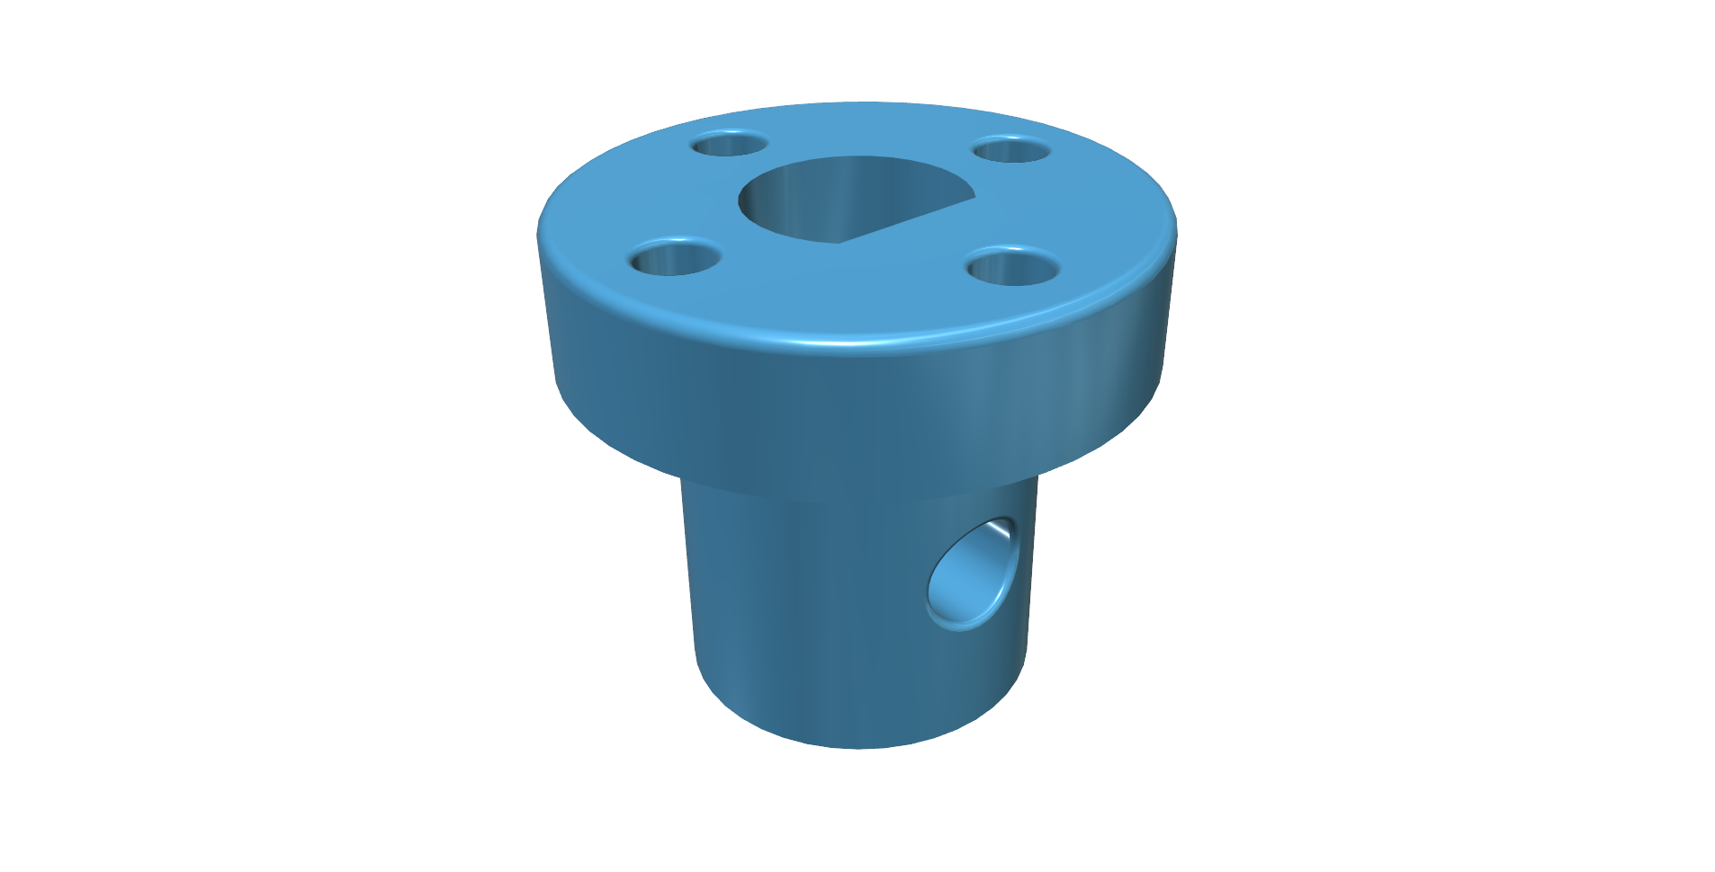
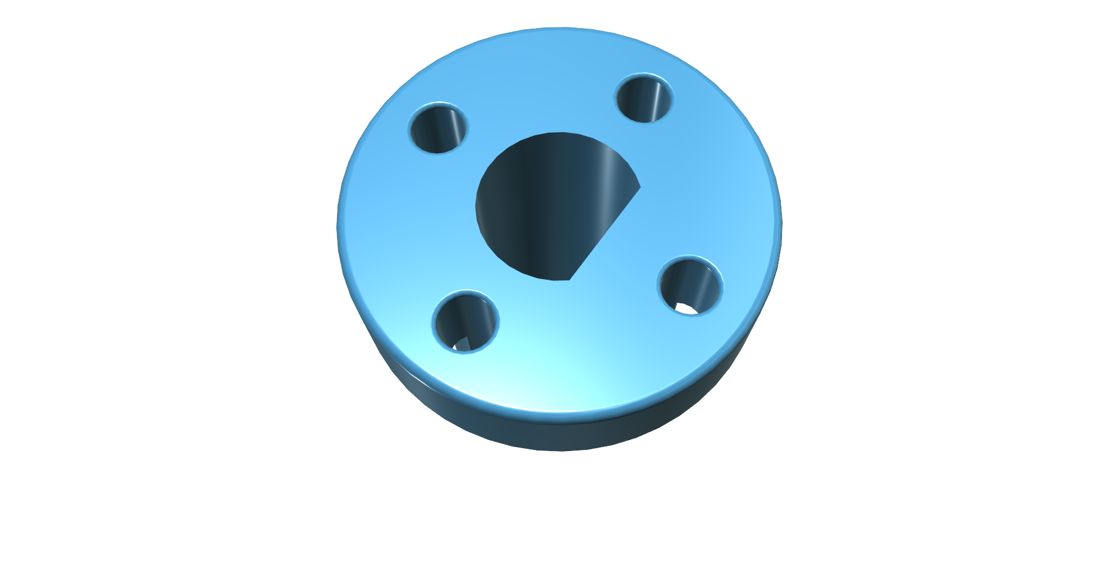
3D designed parts using Autodesk

Slide 10
Position sensor
As their name implies, Position Sensors detect the position of something which means that they are referenced either to or from some fixed point or position. These types of sensors provide a “positional” feedback.
The most commonly used of all the “Position Sensors”, is the potentiometer because it is an inexpensive and easy to use position sensor.
microcontroler
Dc gear motor with TSA
Finger actuation
Feedback using PS

Slide 11
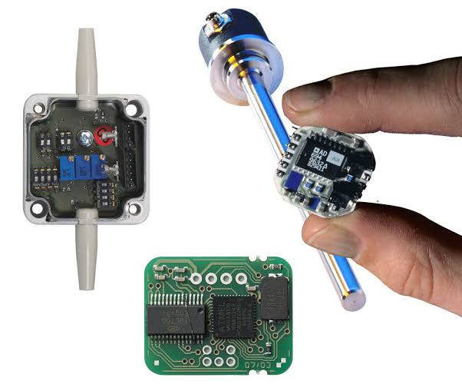
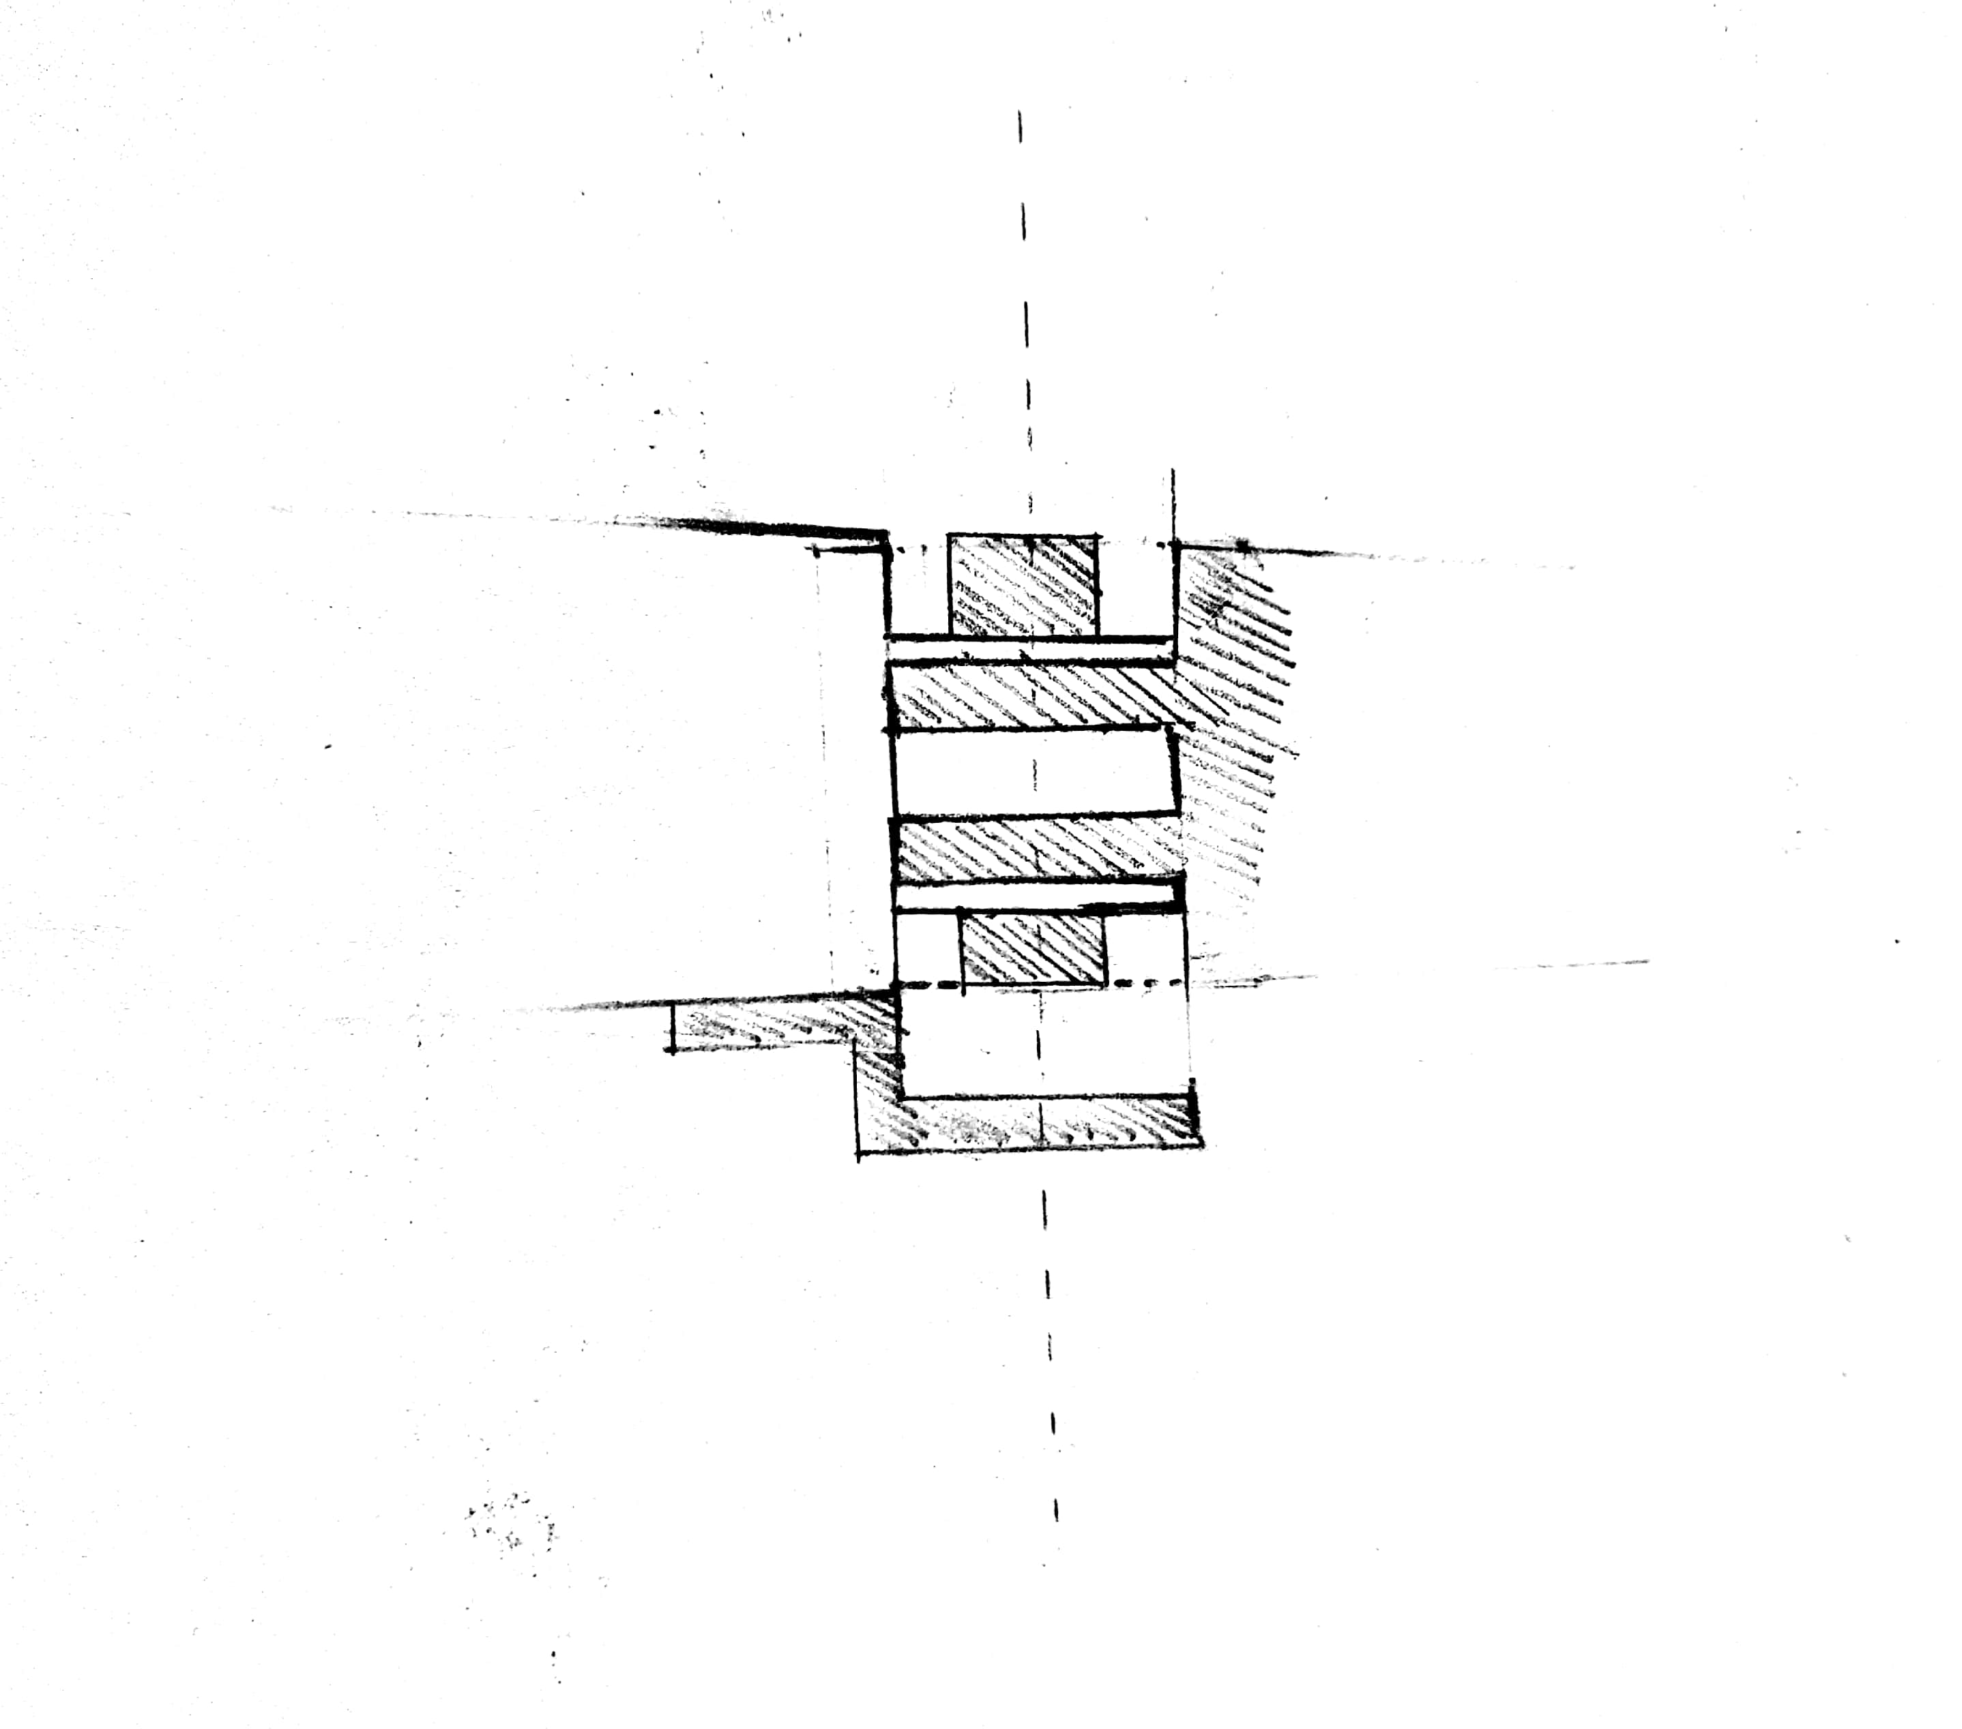
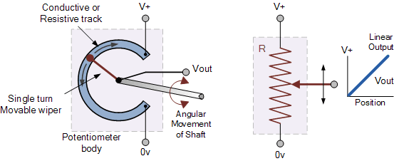
Precision rotary position sensor design and fabrication
Commercially available Position encoders are placed at the back of the motor that provides closed loop feed back by tracking the speed of motor shaft
The most commonly used of all the “Position Sensors”, is the potentiometer because it is an inexpensive and easy to use position sensor.

Slide 12
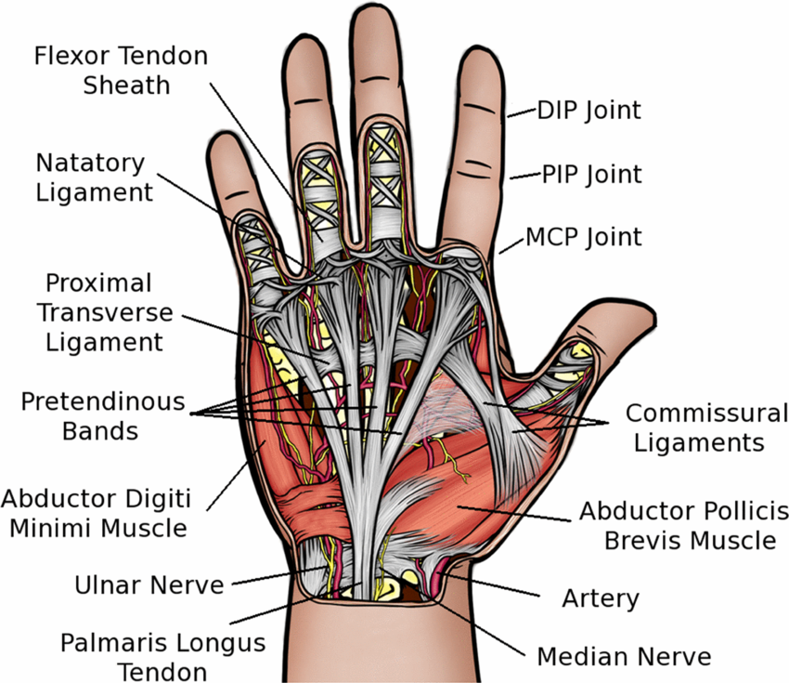
The limited size problem
Average human hand has a dimension of about 94 x 84 mm
How to properly use the limited size of the hand was one of our major issue
Even though our linear actuator design were compact and very efficient with high torque its impossible to place and actuate 30 – 32 linear actuator in 94x84 mm space

Slide 13
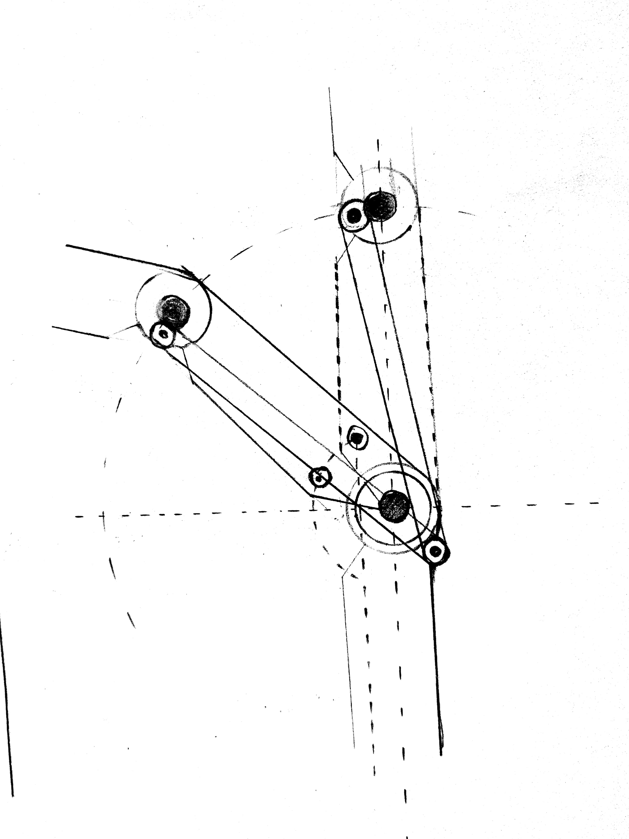
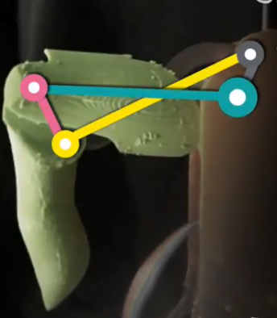
The link and drive mechanism
Here one end of the link is connected to the knuckle
And the other end to pip joint
This simple link mechanism eliminates the use of 1 linear actuators per finger

Slide 14
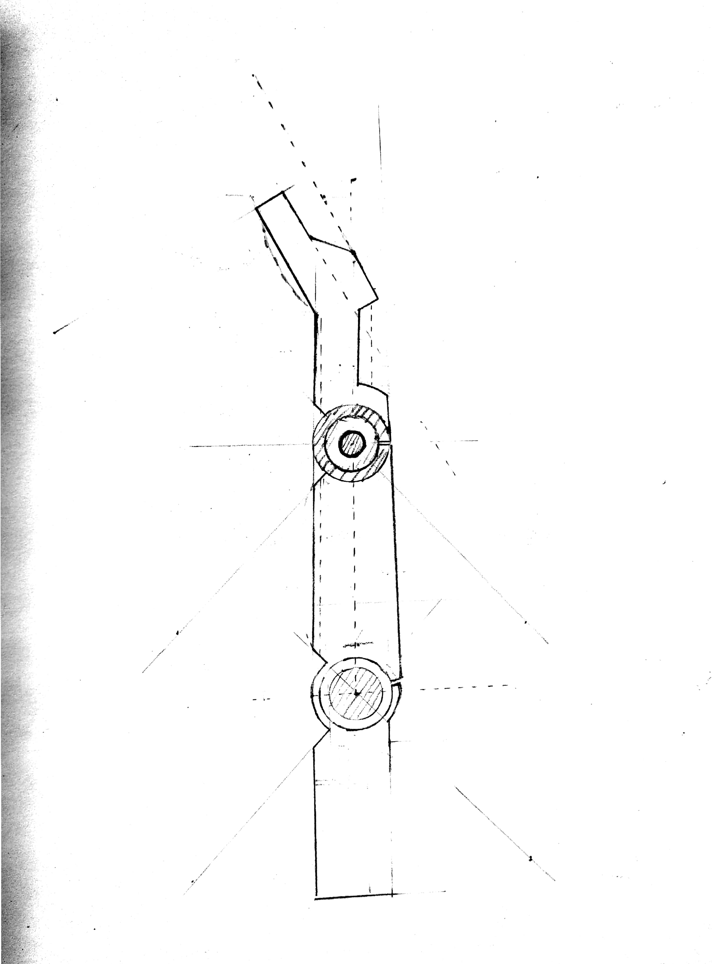
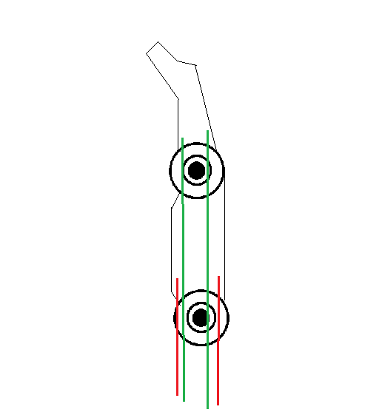
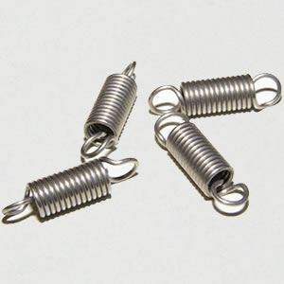
Spring return mechanism
One end of the retracting spring is anchored into the spring housing . The other end of spring is connected to the nylon string the other end of the sting is then connected to the knuckle
This simple but very effective mechanism further eliminates the use of 2 linear actuators
Extension
springs
Higher tensile strength strings are used for twisted string actuation and also the spring mechanism

Slide 15
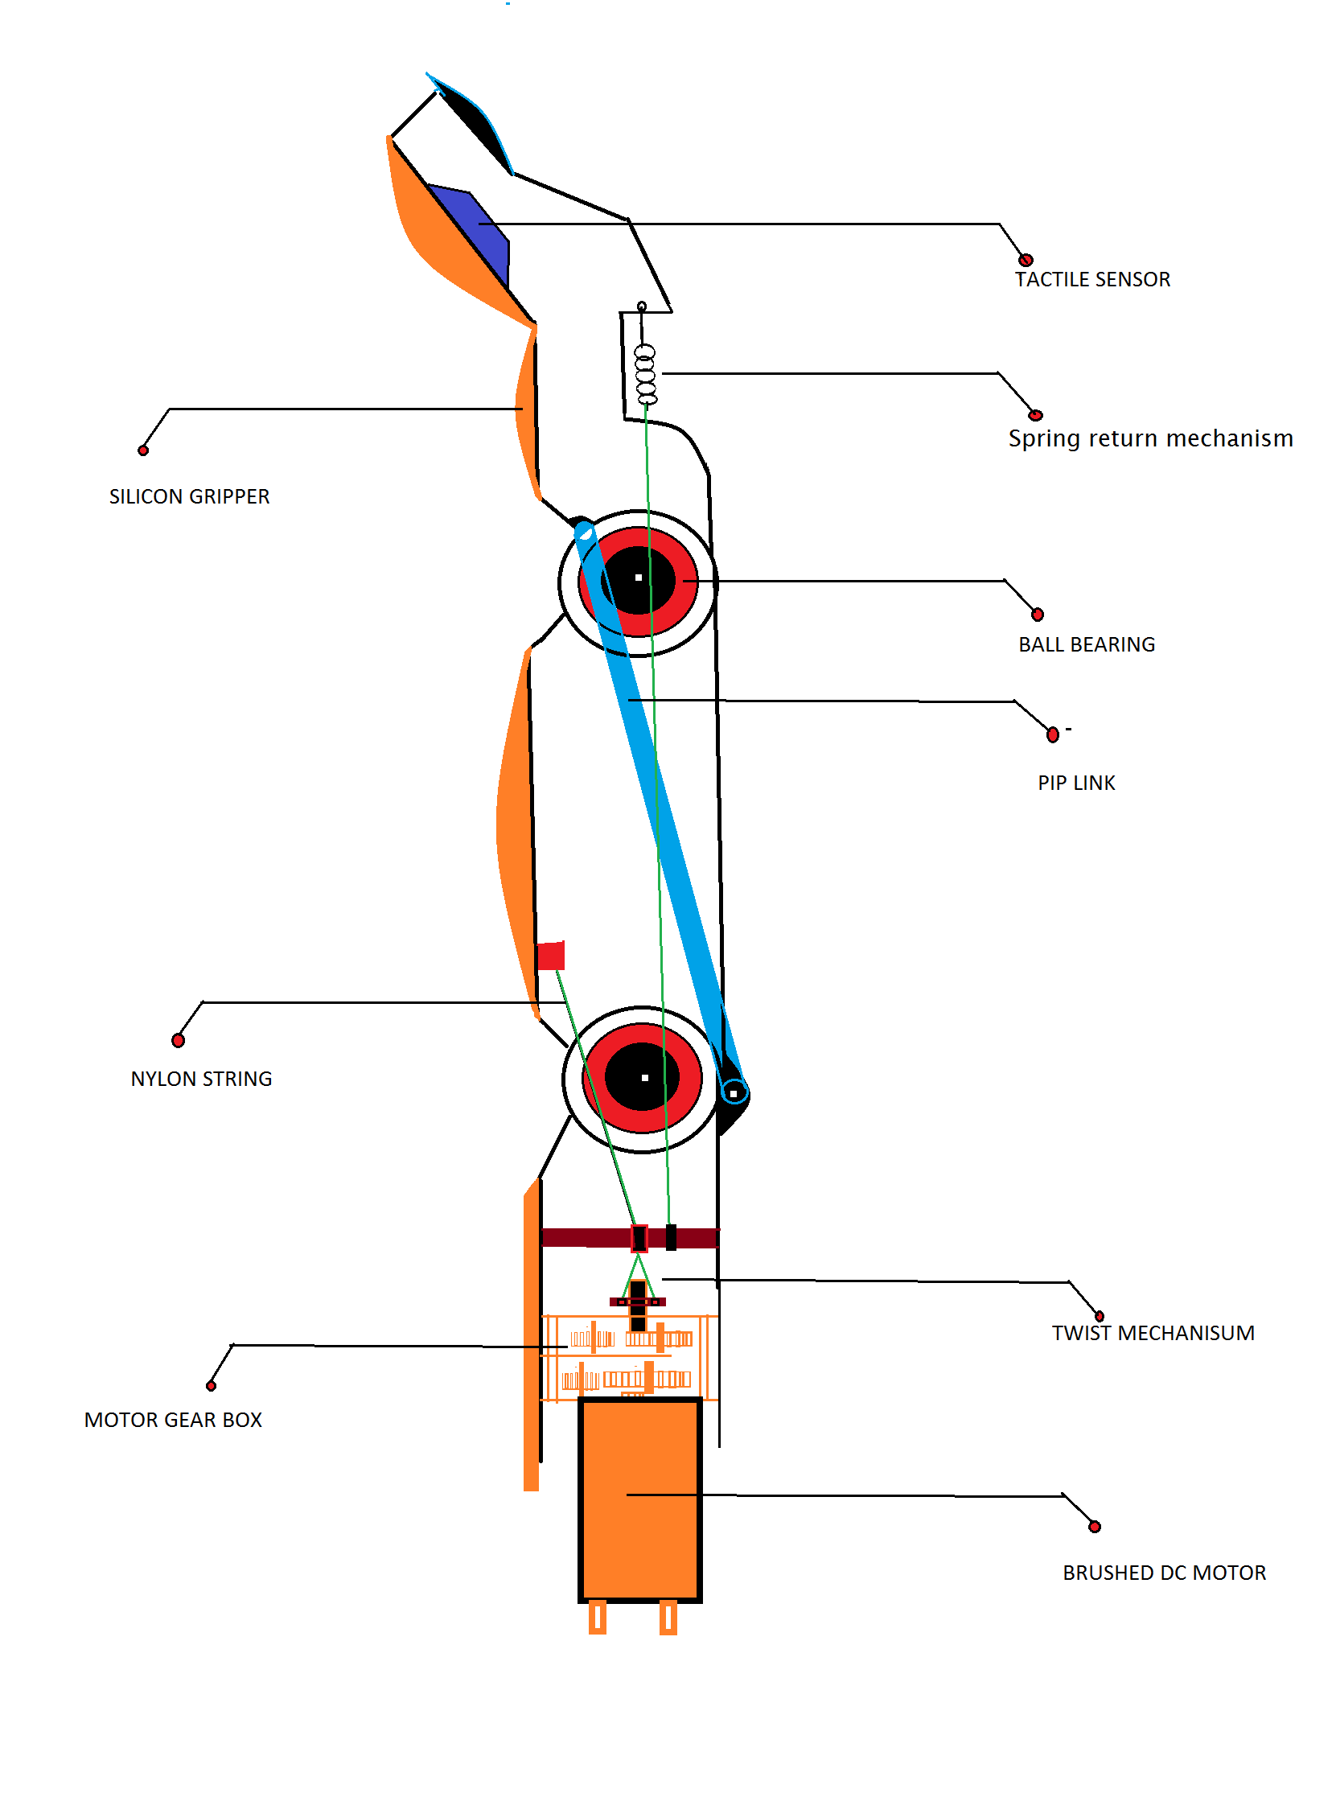
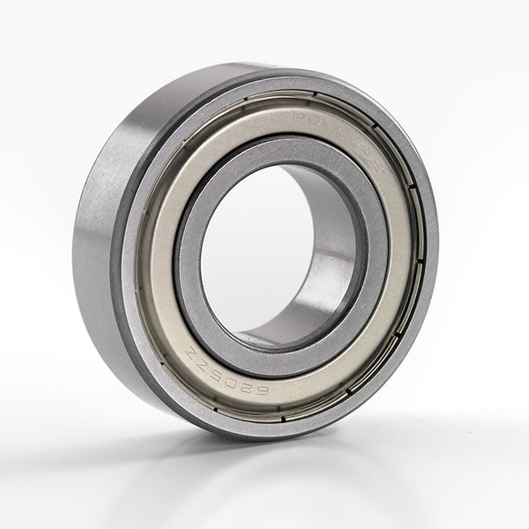
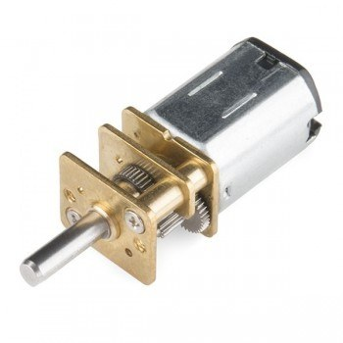
Finger cross-sectional design
Extension
springs
Silicon
skin
Ball bearings
--6x13x5
Gear motor
--300 :1

Slide 16
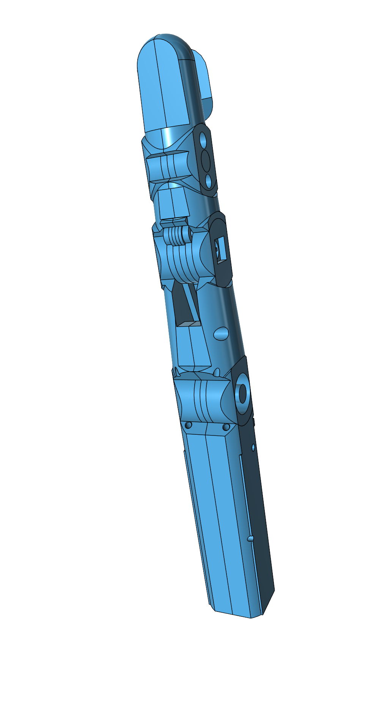
PROTOTYPE V1
Redesigned finger mechanism for more compact and high mobility
Highly sensitive and compliant with force feedback
Stable with no backlash

Slide 17
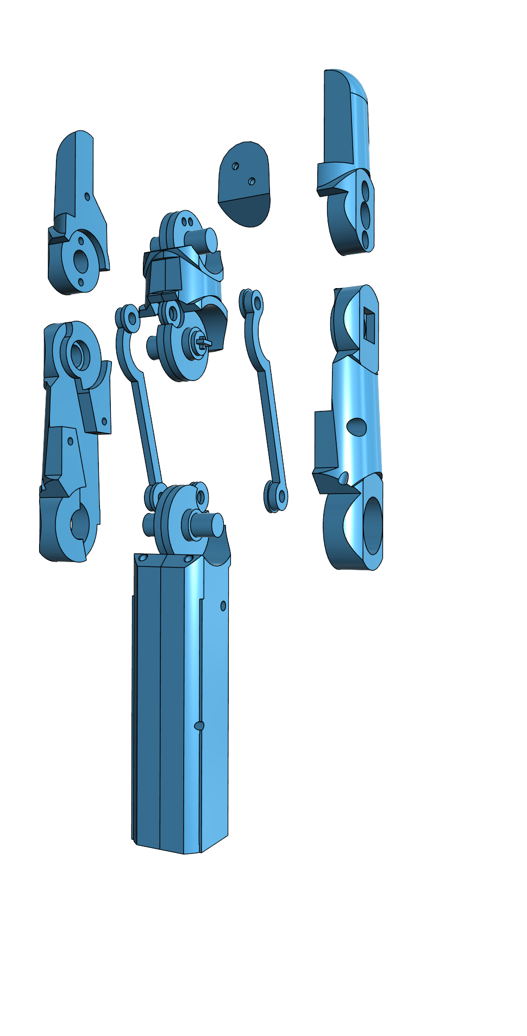
EXPLODED FRONT VIEW
M2 screws
Position sensor
linkage
Ballbearing

Slide 18
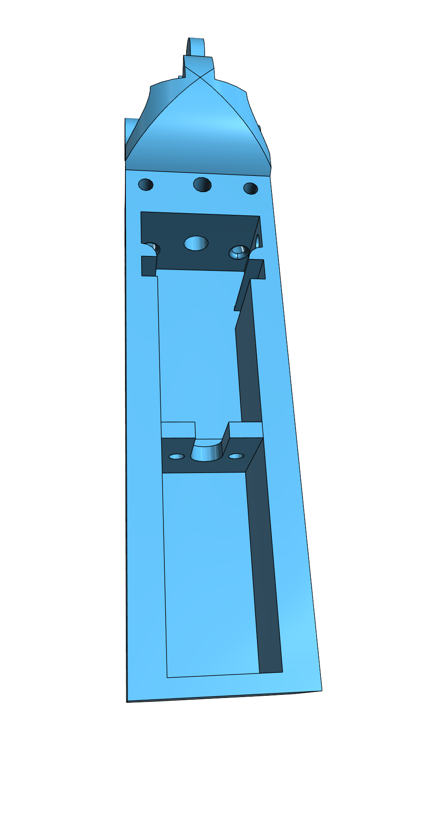
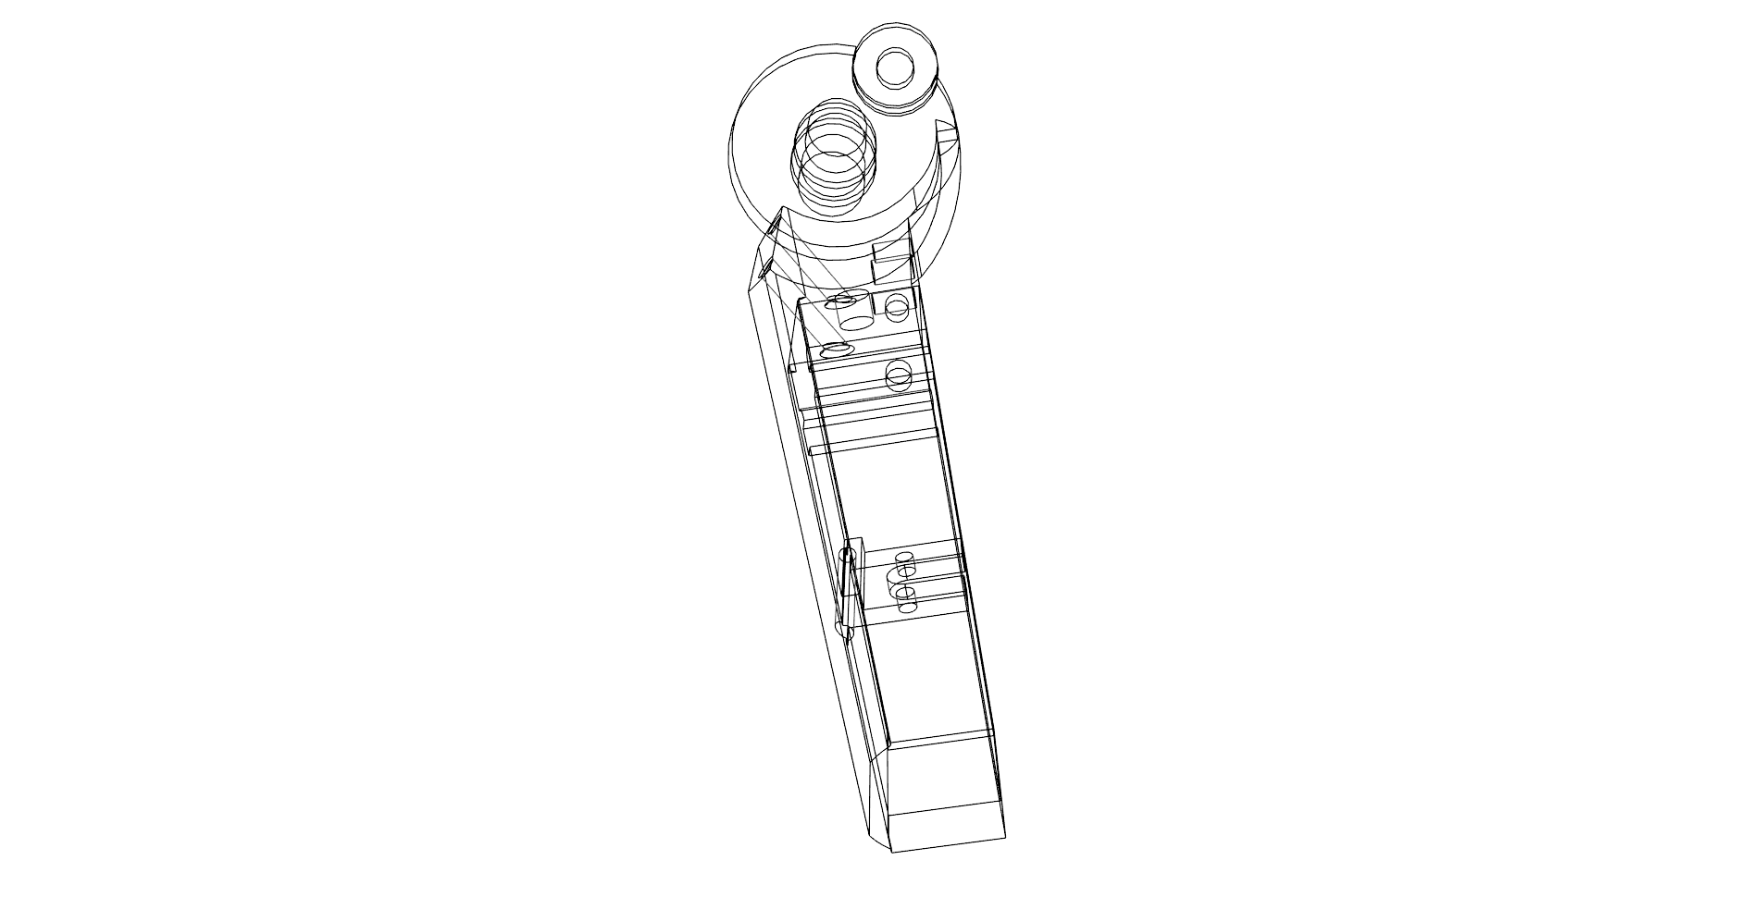
TENDONS
CABEL sleeve
DC GEARED
MOTOR

Slide 19
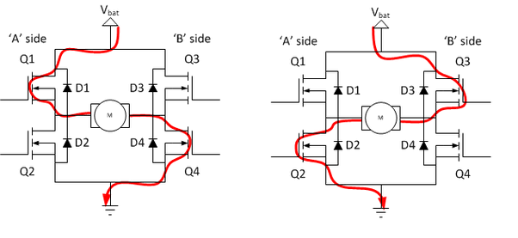
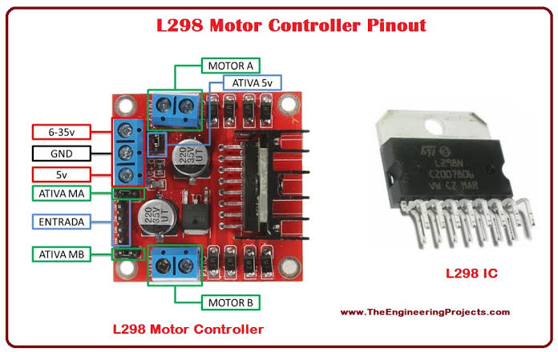
Motor driver L298N
Dual full-bridge driver
Integrated monolithic circuit with 15 pin config
Power supply 5v– 46v , 2A
Integrated filter circuit and diodes to prevent back EMF

Slide 20
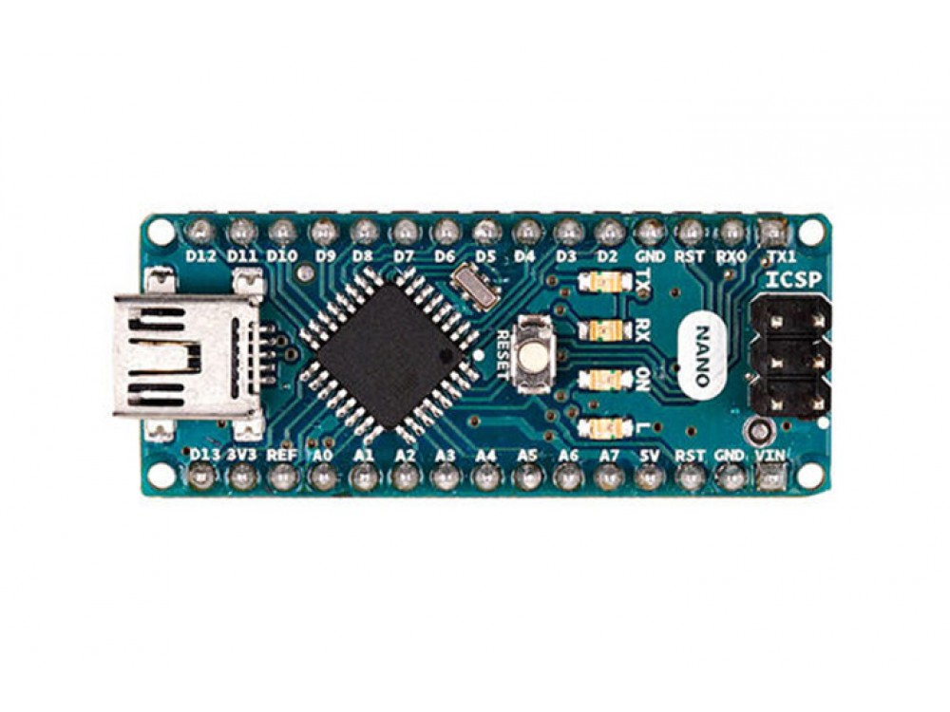
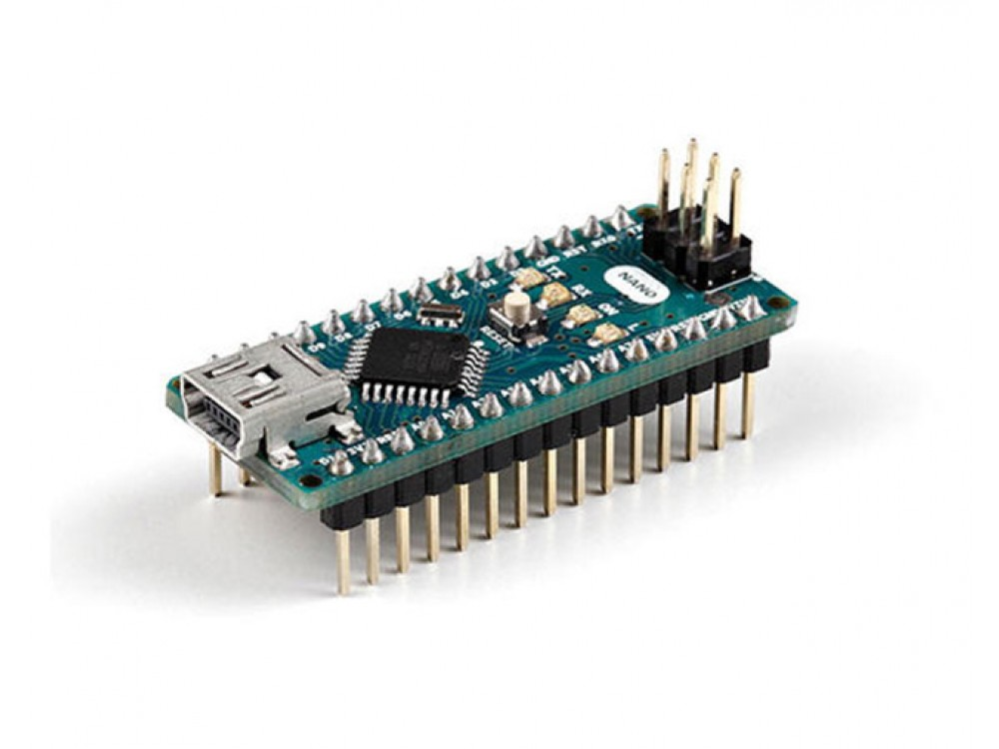
ATmega328
Architecture : AVR
Operating voltage : 5V
Flash Memory : 32kb
Clock speed : 16Mhz
Analog in pins : 8
Digital i/o pins : 22

Slide 21
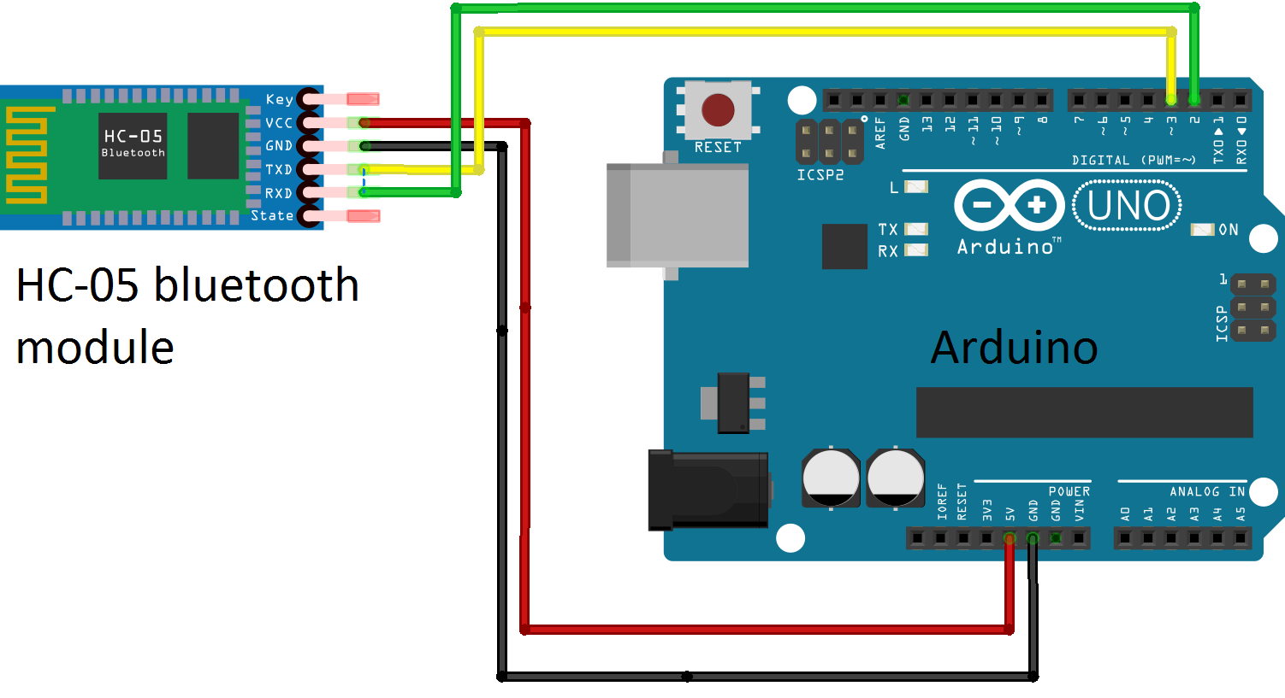
Bluetooth interface HC-05
Frequency : 2.4GHz
Modulation : GSFK (Gaussian frequency shift keying)
Emission power : 4db , class2
Security : Authentication and encryption
HC-05 module is an easy to use Bluetooth SPP (Serial Port Protocol) module, designed for transparent wireless serial connection setup.
UART interface with programmable baud rate
With integrated antenna
Power supply : +3.3vDC 50mA

Slide 22
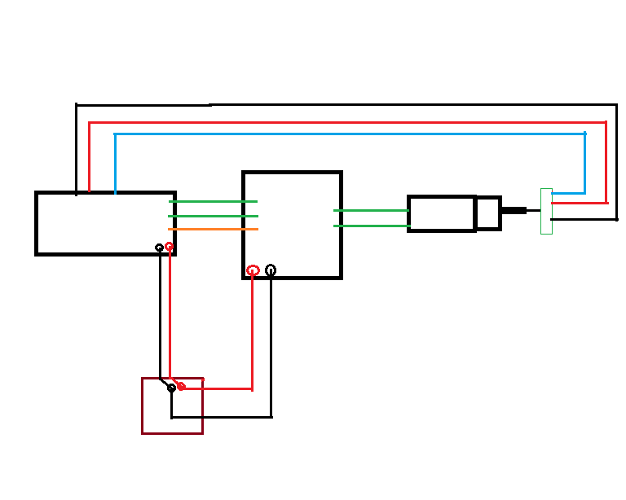
Closed loop control with feedback
B
L
U
E
T
O
O
T
H
10k pot
D2
D3
D5
M1
M2
PWM
VCC
GND
RX
TX
GND 5V a0
Atmega 328
Dc motor
12v
HC-05
Motor driver
L298n
Power supply
12v

Slide 23
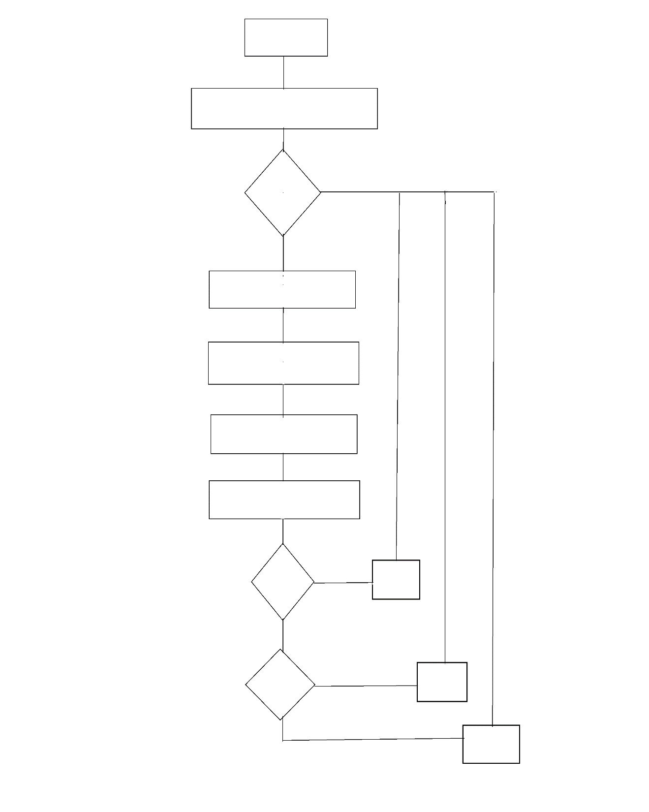
START
ALGORITHM FOR CLOSED CONTROL LOOP
SET-UP I/O
LOOP
GET WANTED POSITION
GET CURRENT POSITION
CALCULATE GAP
CALCULATE SPEED
IF CA < WA
YES
RUN
CW
NO
YES
RUN
CCW
IF CA >WA
NO
STOP

Slide 24
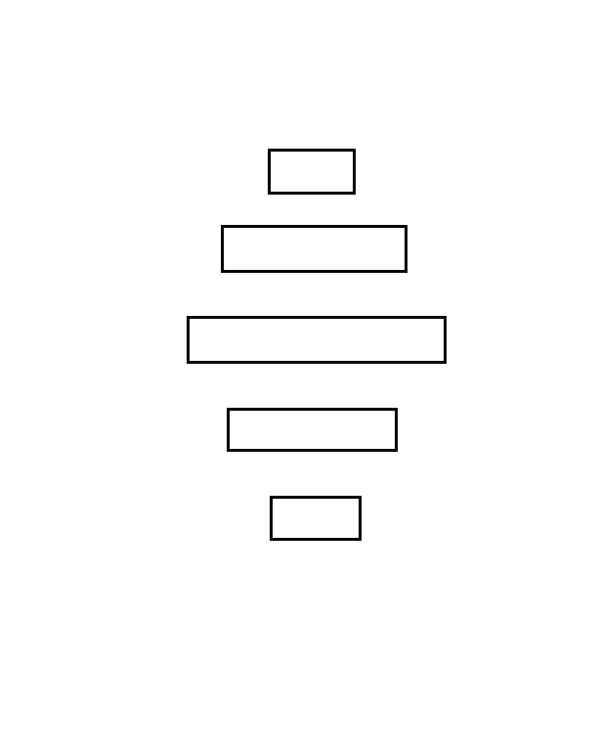
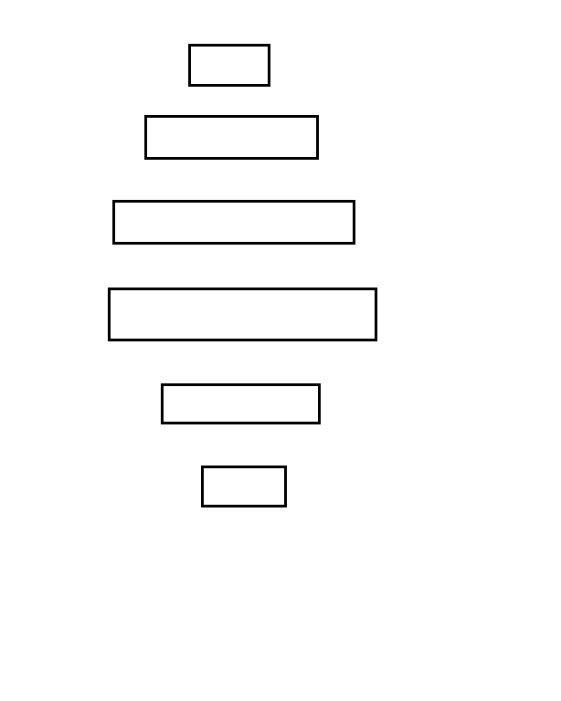
ALGORITHM TO :: GET WANTED POSITION
ALGORITHM TO :: GET CURRENT POSITION
START
START
ANALOG READ
ANALOG READ
MAP(523,1023,0,90)
MAP(VAL,523,1023,0,90)
CONSTRAIN (543,1000,0,90)
RETURN VAL
RETURN CONST
STOP
STOP

Slide 25
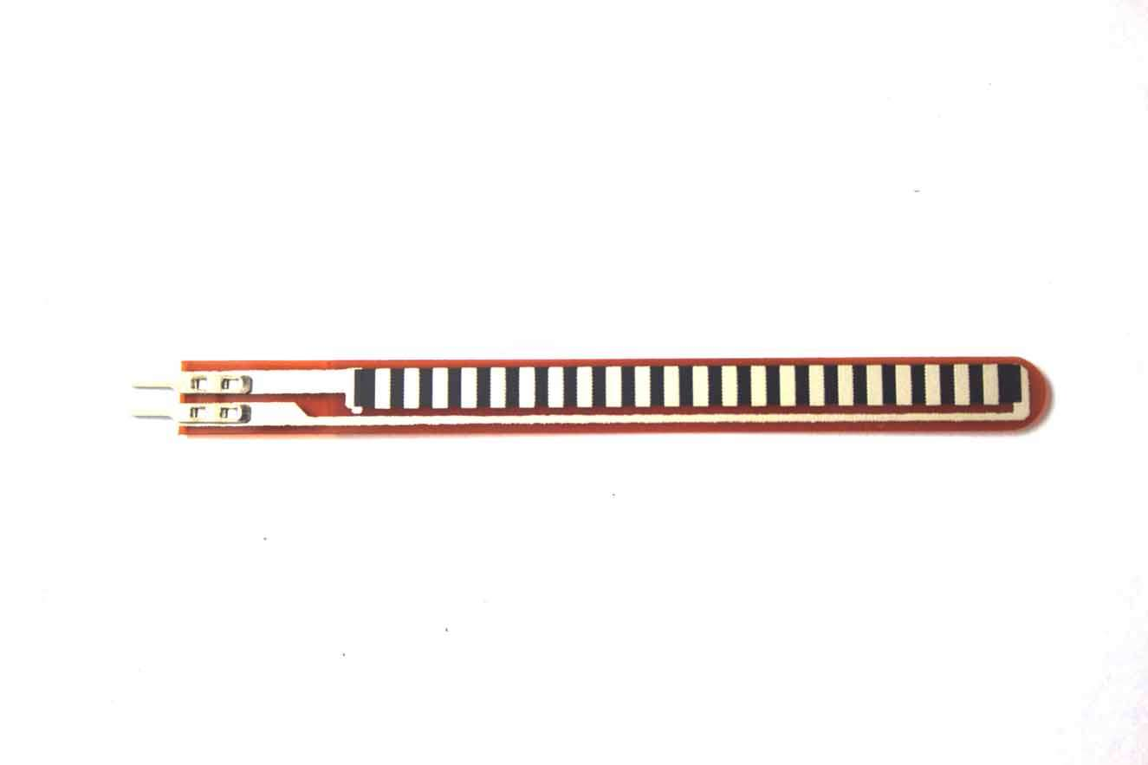
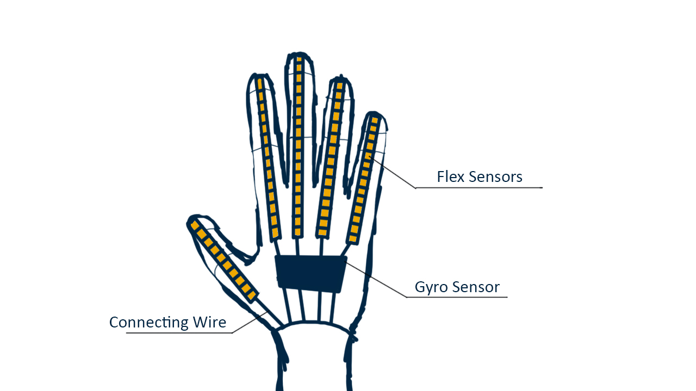
Existing data glove
The Flex Sensor patented technology is based on resistive carbon
elements.

Slide 26
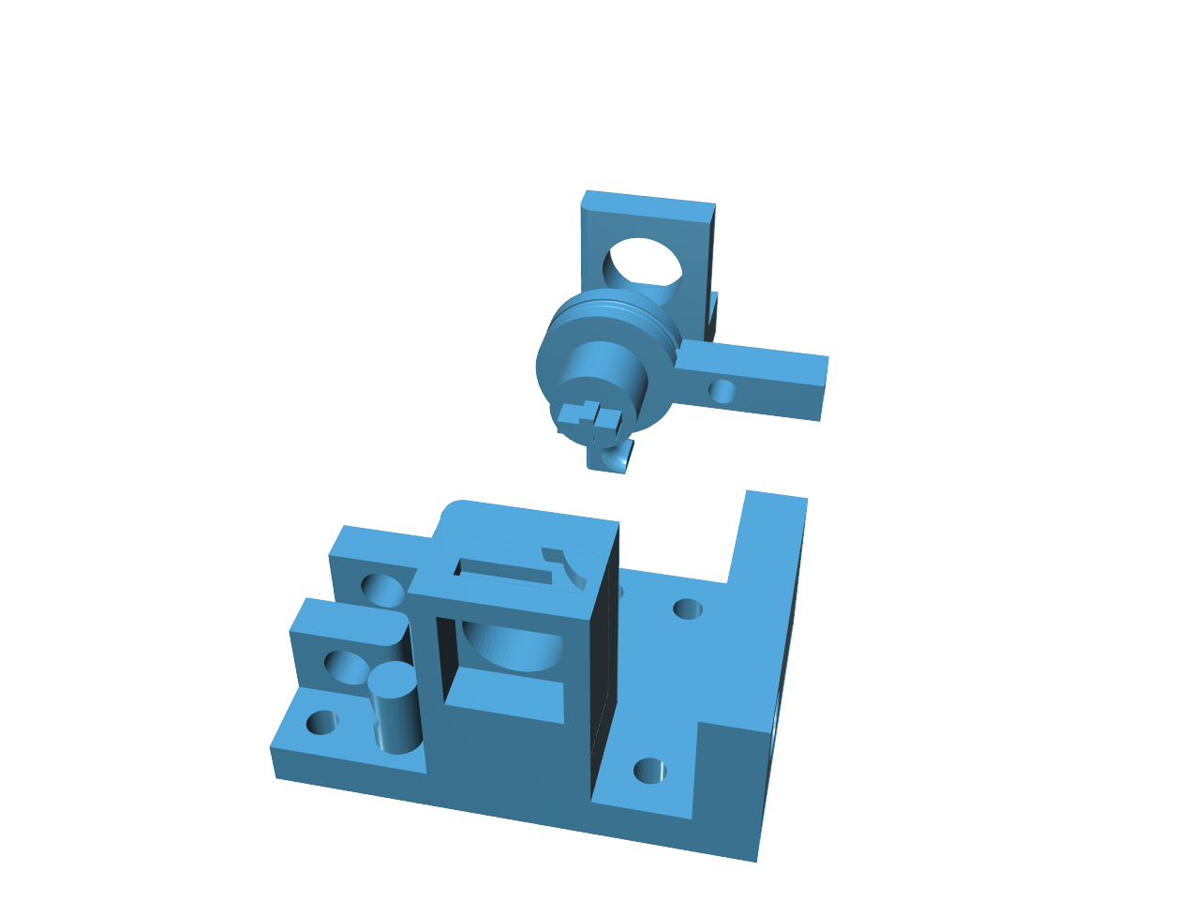
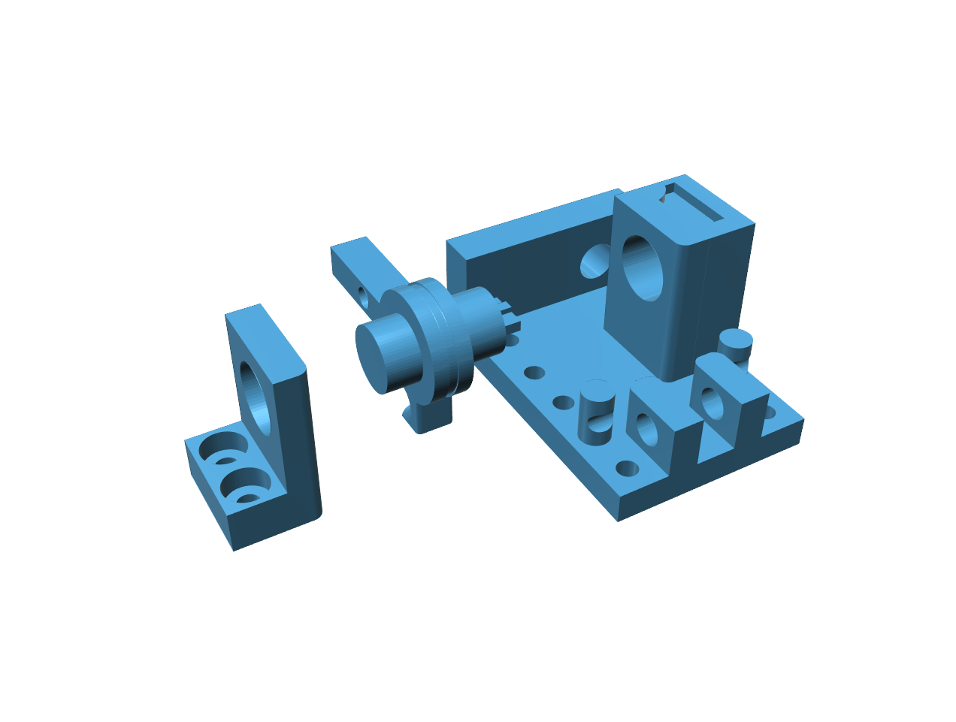
DATAGLOVE SENSOR MODUAL DESIGN
LEFT SIDE VIEW
RIGHT SIDE VIEW

Slide 27
Block diagram for data glove
Position sensor
B
L
U
E
T
O
O
T
H
AT mega 328
Position sensor
VCC
GND
RX
TX
Position sensor

Slide 28
Application of data glove
Automotive controls
Medical devices
Industrial controls
Computer peripherals
Fitness products
Musical instruments
Measuring devices
Virtual reality games
Consumer products
Physical therapy

Slide 29
CONCLUSIONS
This paper presents a design and actuation system for a prosthetic hand.
The actuation structure was shown to effectively execute grip configurations similar to those found in the three primary grips of the human hand (power, pinch, and lateral).
The design also showed the ability of an underactuated and nearly fully actuated kinematic structure to exist in a single actuation system using remarkably different types of actuators, without compromising the required size and weight of the prosthetic hand.

Slide 30
REFERENCES
[1] Bicchi, A., 2000, “Hands for dexterous manipulation and robust grasping: a difficult road toward simplicity”, IEEE Transactions on Robotics and Automation, 16(6):652-662.
[2] Foegelle, M., Li, K., Pavacic, A., Moller, P., “Test & Measurement: Developing a Standard Hand Phantom for Wireless Testing,” [Online]. Available: http://www.wirelessdesignmag.com/ShowPR.aspx?PUBCODE=055& ACCT=0029956&ISSUE=0811&RELTYPE=tm&PRODCODE=W02 60&PRODLETT=A&CommonCount=0,
[3] Norkin, C., Levangie, P., 1992, Joint Structure & Function: A Comprehensive Analysis: Second Edition, F. A. Davis Publications, 262-299.
[4] Nelson, D. L. “Tendon Laceration Page,” [Online]. Available: http://www.davidlnelson.md/Tendon_laceration.htm,
[5] Valero-Cuevas, F. J., Towles, J. D., Hentz, V. R., “Quantification of fingertip force reduction in the forefinger following simulated paralysis of extensor and intrinsic muscles,” Journal of Biomechanics 33 (2000) 1601-1609.
[6] Kevin G. Keenan, K. G., Veronica J. Santos, V. J., Venkadesan, M. and Valero-Cuevas, F.J., Maximal Voluntary Fingertip Force Production Is Not Limited by Movement Speed in Combined Motion and Force Tasks, The Journal of Neuroscience, July 8, 2009 • 29(27):8784–8789. [

